Slide 1
MYrENTALS – Case Analysis
Abhinav Gaur, Jan-e-Alam, Amanda Witt, Anusheel Pandey, Mike Jackson, Prashant Saxena

Slide 2
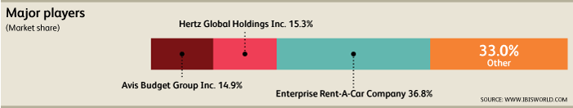
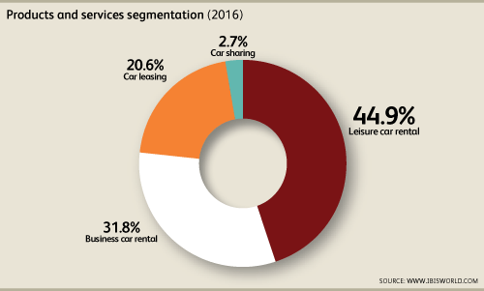
To match…or not to match
INDUSTRY OVERVIEW
The Car Rental industry is in the mature stage of its life cycle. Over the 10 years to 2021, industry value added, which measures an industry's contribution to GDP, is expected to grow at an annualized rate of 1.3%
High level of market share concentration, with the industry's four largest companies expected to generate over 67.6% of industry revenue.
Competition in this industry is high and the trend is increasing.
PROBLEM STATEMENT
We trail Hertz by 1.5% market share in the car rental industry. Hertz introduced a “return car with no fuel” option at $3.75/gallon. Should we (MyRentals) attempt to compete with Hertz in this space or maintain our current strategy?

Slide 3
Facilities Costs
Staff Training Costs
Fixed Costs
Administrative Costs
There are opportunities to maintain costs
Marketing/Advertising Costs
Fuel logistics & Storage Costs
Zero fuel program will add value for MyRentals
Variable Costs
Extra insurance Costs
Maintenance Costs
Gas price projections
Price
Premium = Offering price – Gas price
There are opportunities for increased revenues
Willingness of customers
Demand
Retention of existing customer base
Expansion of existing customer base

Slide 4
Executive Summary
MyRentals’ strategy to analyze the profitability of “Return Car with No Fuel” program will be based on 2 factors:-
Limiting any additional costs
Making strategic cuts in costs
Limiting Fixed Costs:- Implementation of the program may lead to additional facility, administrative, and staff-training costs. These costs can be restrained with the accurate estimation and planning and under optimal conditions.
Limiting Variable Costs:- MyRentals will have to invest in marketing to ensure the customers are aware of the new program. Fuel logistics costs and maintenance costs are also extremely critical but can be contained by partnering with local nearby gas stations and with automobile body shops.
Pricing Strategy:- MyRentals should adjust its pricing strategy on the basis of fuel prices at that point. It can match Hertz’ pricing strategy at present but it will have to reduce the premium it currently charges in case of a potential price war with Hertz and in case fuel prices rise. This will allow MyRentals to retain its present customers and attract potential new customers.

Slide 5
Issue | Hypothesis | Analysis | Data Source | End Products | Responsibility | Timing
Facility Costs | Rollout of the program will require investments in additional facilities | a) Benchmark facility costs b) Come up with ideas to trim facility costs | Annual Reports, Balance Sheets | Estimate the facility costs we will incur due to the roll-out of the program
Staff-training Costs | Rollout of the program will require training of staff for the new program | a) Benchmark staffing costs b) Creation of an optimal training plan | Annual reports, Income statements | Estimate the cost to train our staff regarding the new program
Admin Costs | Rollout of the program will result in incurring of admin costs like new forms, legal costs etc. | a) Estimate the additional costs in printing of new forms b) Estimate additional legal costs | Industry experts, Analyst reports | Estimate the cost of additional administrative tasks that will result from this program
Marketing/Advertising Costs | There will be additional marketing and advertising costs due to the rollout of the plan | Estimation of the additional costs that will be incurred to market and advertise the new plan | Annual reports, Industry experts | Estimate the expenses arising from marketing and advertising of the new program
Fuel Logistics & Storage costs | There may be additional costs to take care of the fuel logistics | Analyze how Hertz and other competitors take care of added fuel and logistic costs | Industry experts, Industry journals, Annual reports | Estimate any additional costs pertaining to fuel logistics and/or storage
Extra Insurance costs | Rolling out the program will result in a revision of our auto-insurance premiums | Estimate the additional premiums per vehicle that will arise from the rollout of this program | Industry experts, Industry Journals | Estimate the increase in our per vehicle premiums post the launch of the program
Maintenance costs | Roll out of the program will result in additional maintenance costs for our fleet of vehicles | Estimate the additional maintenance costs for the vehicle fleet | Industry journals, Industry experts | Estimate the increase in vehicle maintenance costs

Slide 6
Issue | Hypothesis | Analysis | Data Source | End Products | Responsibility | Timing
Gas Price Projections | Fluctuations in gas prices will have an impact on the bottom-line after the launch of this program | Analyze gas prices trends & current market conditions; Also keep an eye on geo-political events | Analyst Reports, Industry Journals | Estimate the impact that fluctuating gas prices might have on the bottom line
Premium = Offering Price – Gas Price | What’s the premium that we charge for this program? | a) Benchmark the prices that other companies charge for similar programs b) Revisit our costs to make decision on pricing | Annual reports, Income Statements | Estimate the per-gallon premium that should be charged as a part of this program
Willingness of customers to embrace the program | Does our average customer even want this feature? | Analyze surveys and reports regarding customer habits and preferences in the car-rentals industry | Industry journals. Expert interviews | Estimate the demand for ‘no-fuel-return’ programs in the car-rentals industry
Retention of the existing customer base | How do we make sure we retain our existing customer base? | Analyze the impact of the program on our existing customer base | Industry journals. Expert interviews | Estimate the impact of introducing this program on MyRentals existing customer base
Expansion of the existing customer base | Can we expand our existing customer base and/or enter other segments with the launch of this program? | Project any increases in our customer base owing to the launch of this program | Industry journals. Expert interviews | Estimate the increase in MyRentals customer base that may arise from this program and/or other factors

